Slide 1

Run-Length Coding (RLC)
Binary images contain only 0s and 1s. We read pixels row by row. Instead of saving every pixel, RLC stores the value and how many times it repeats (run length).
Why use RLC?
What it stores
How to read
Saves space by recording repeated pixels once instead of many times.
Pairs of (value, run length) — e.g., (1,3) means three 1s in a row.
Scan left→right across each row, counting consecutive equal pixels.
Step-by-step example (single sequence)
Given sequence: 1110001
Count 1s → 111 → (1,3)
Count 0s → 000 → (0,3)
Count 1 → 1 → (1,1)
Final RLC: (1,3), (0,3), (1,1)
IT22017 & IT22018

Slide 2
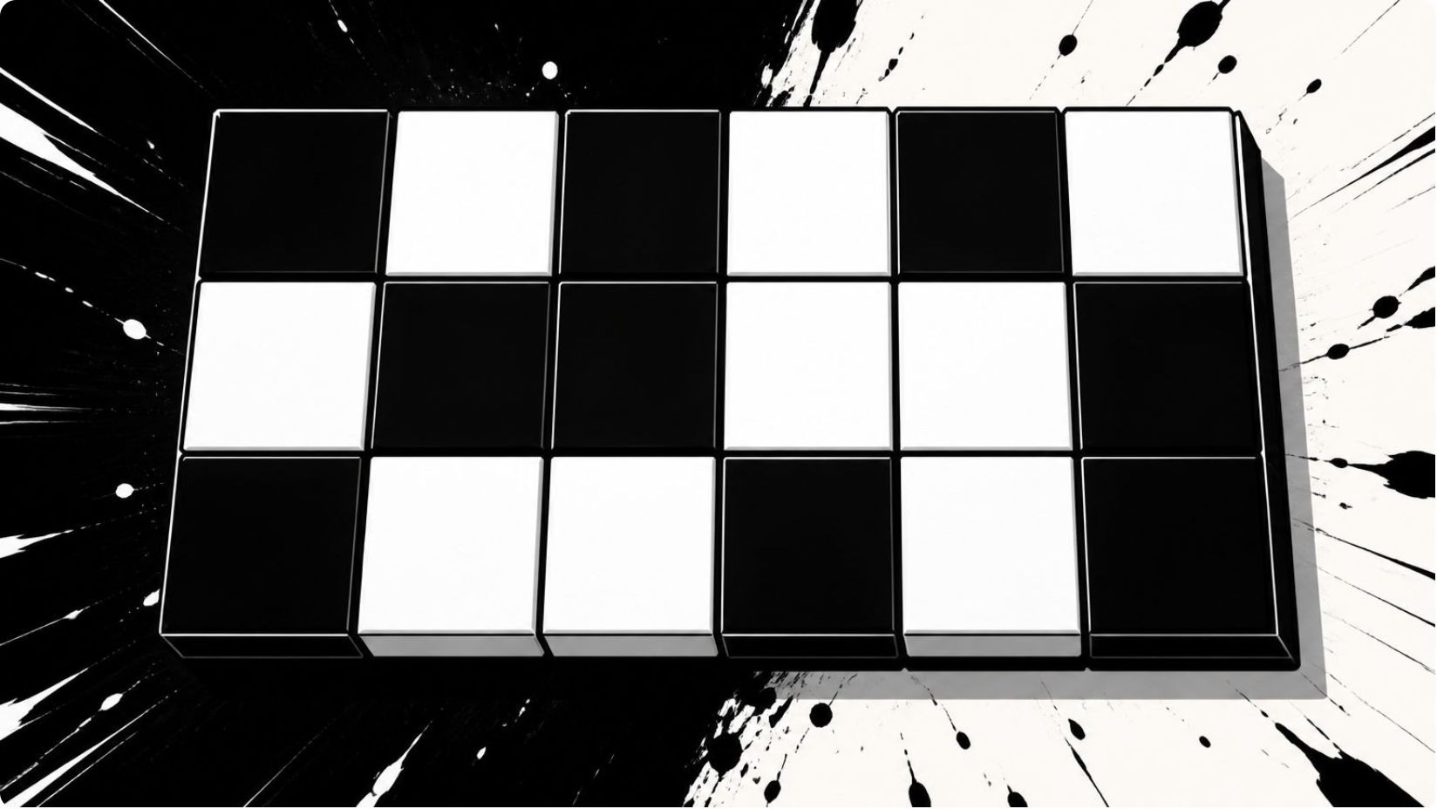
RLC Example from Binary Image
Encode each row separately. Start at the first column and count continuous values.
One row — step-by-step
Row 0: 0 0 0 1 1 1
Step 1: three 0s starting at column 0 → (row 0, start 0, value 0, run 3)
Step 2: three 1s starting at column 3 → (row 0, start 3, value 1, run 3)
Another row — results
Row 1 result: (row 1, start 0, value 1, run 2), (row 1, start 2, value 0, run 4)
Format to use
Quick takeaway
(row, start column, value, run length)
RLC stores repeated pixels efficiently.
IT22017 & IT22018

